Slide 1
Project: Kickstarter dataset Prepared for: Dr. Rahul Bhaskar ISDS 415 Spring 2018
BY: Tanisha munshi
CWID: 893312868

Slide 2
introduction
Dataset: Taken from https://www.kaggle.com/kemical/kickstarter-projects/data
Describes the projects which have been funded through Kickstarter over the period of 2009- 2018

Slide 3
Data description
An aggregate collection of projects since the inception of the company
Includes distinct categories such as Arts, Films, Comics, Music, Journalism Technology, etc
Each category has variety of the information such as what was the initiate funding goal and what was the campaign time. Was the project successful? Was it based out of US, or other countries? How many backers each project had
These specific columns gave us insight into factors influencing a successful Kickstarter project

Slide 4
Data preparation
Aggregated dataset did not need any cleaning or preparation for our in-depth analysis
Data seemed consistently formatted
The aggregator used “State” to signify the outcome of the projects at the end of it is deadline.

Slide 5

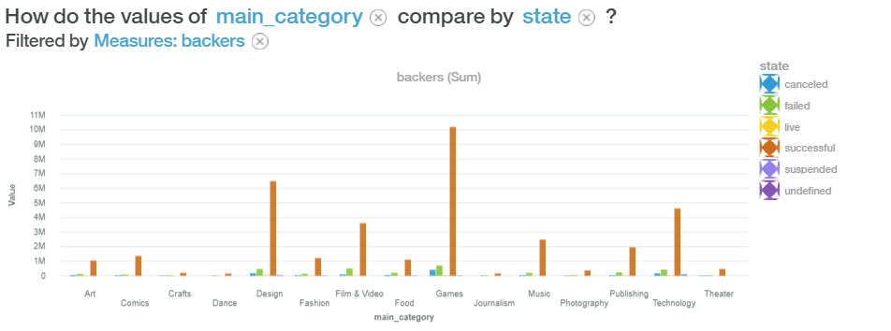
Finding #1: Bar graph illustrating type of Categories
What type of projects are more successful than others and effect of Backers on the Projects

Slide 6
insights
The Bar chart above depicts the number of backers in each category of the projects. It also shows the number of project in each status of Failed, Successful, and Cancelled Projects.
Games Category has the highest number of backers funding the project. Whereas Film and Video category has the highest count of failed projects with few backers interested in their project.
For each failed project, there would almost be the same amount of successful project since the inception of Kickstarter.

Slide 7
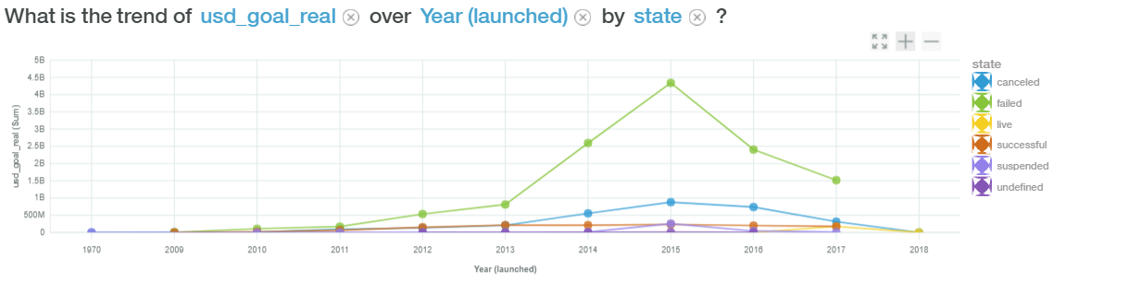
Finding #2: Line graph depicting yearly USD Goal and USD Pledged
What is the relation between the yearly USD and pledged goal depending on the campaign status?

Slide 8
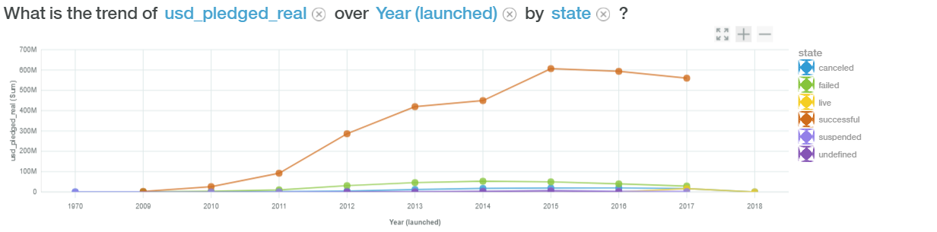
Finding #2: Line graph depicting yearly USD Goal and USD Pledged
What is the relation between the yearly USD and pledged goal depending on the campaign status?

Slide 9
Insights
The line graph above shows the USD Goal and USD Pledged amounts depending on the status of the campaign.
The status included in the graph are canceled, failed, and successful.
The company generates revenue if the campaign is successful (goal reached) and takes 5 % from the pledged amount. So, the higher the pledged amount for successful campaign, the higher is the revenue for Kickstarter.

Slide 10
insights
If a project sets a goal of 1 Billion Dollar for a 30 to 60-day campaign time, then it calls for inevitable failure
Successful projects have reasonable goals that could be achieved in a 30 to 60-day period. Backers are resistant to support projects with high value goal for a brief period of campaign time.

Slide 11
Conclusion
Visualization help users to gain insightful information at a glance.
Analyzing a large set of data can be difficult to tackle, however, with the tools provided, the user is capable to compare different dimensions and dissect each variable in several ways.
By allowing on-the-fly changes to the dimension, users can quickly change what they are analyzing without having to recompile the dataset to achieve the output they want.

